Slide 1

HR Analytics Final Presentation
Team:
Omkar
Ashraf
Poonam
Sagar
Jyoti
Praveen

Slide 2

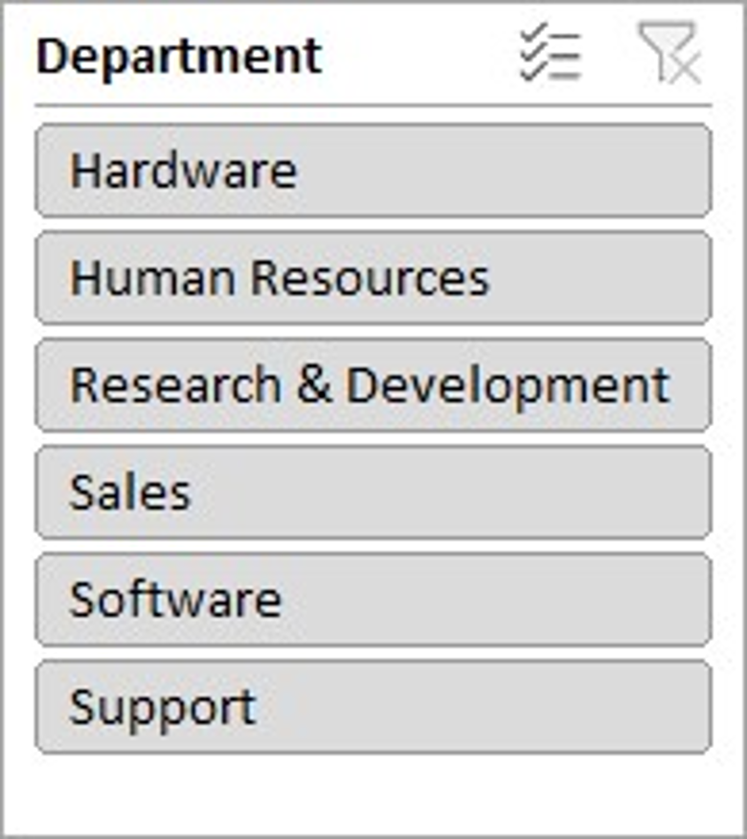
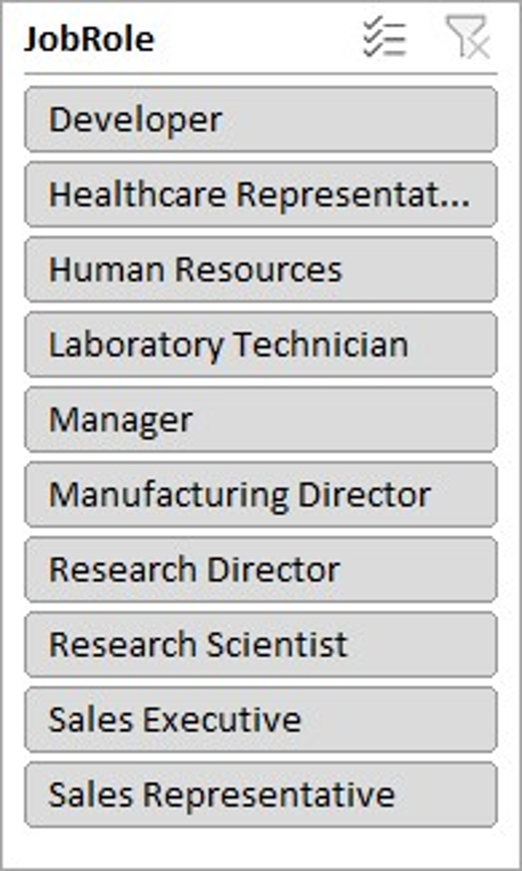
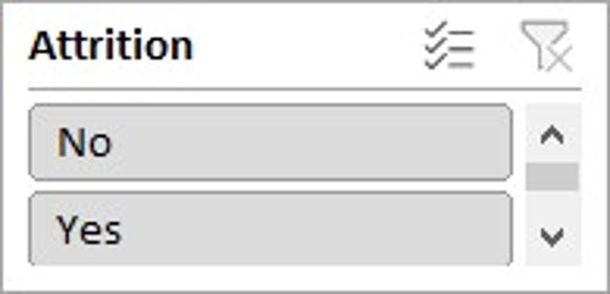
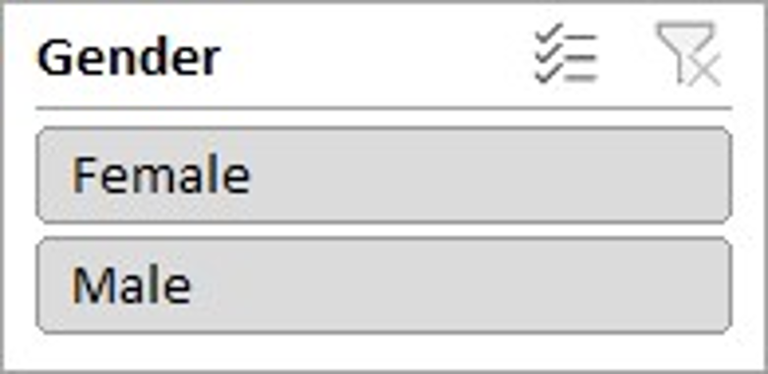
HR ANALYTICS
Overall Employees
50000
Attrition
24895
Average Attrition Rate
50.21%
Average Hourly Rate
115.43
Average of Working Years
20.50

Slide 3
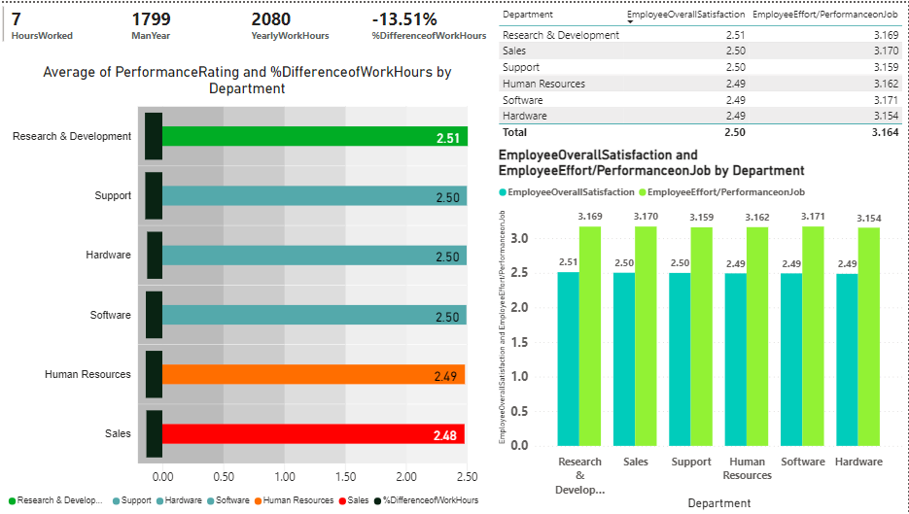
KPI 1 : Performance Rating and % Difference Work Hours:
Cards:
Hours worked – which is calculated by daily rate/hourly rate Since daily rate = hourly rate * Hours worked
2) Man Year =
Hours worked*5*52(no of weeks in a year) Since the standard hours is Biweekly. For one week the work hours is 40 based on the assumption that the company works 5 days a week and 8 hours of day.
3) % Difference of Work Hours =
Man Year – Yearly Work Hours/ Yearly work Hours We Know that for a Year the work hours should be 2080( 40 hours a week 52 weeks in a year, 40 * 52 = 2080)

Slide 4
KPI 1 : Performance Rating and % Difference Work Hours:
As Per KPI 2.1
Sales have the second Highest work hours after Hardware for that year but still the performance rating of sales is given the lowest the,
for the Research and development, they have the least working hours compared to other dept. But the performance rating is the highest.
Now there could be various factors involved in performance rating of Dept., But we are going to analyze the possible ones provided in our data we are going to perform some calculations which are
Employee Overall Satisfaction – AVG(job involvement, job satisfaction, relationship, environment, work life balance)
Environment Efforts on Job Based on – AVG(Education, Job level, Training Times Last Year)

Slide 5
KPI 1 : Performance Rating and % Difference Work Hours:
Insights :
1) Sales have a higher effort on job and
2) There overall satisfaction in job is just second to research and development. And also
3) The man year of the sales dept is second highest
Recommendations:
We can conclude with this fact that the efforts of Sales dept is much to be appreciated and they should be provided with a higher performance rating

Slide 6
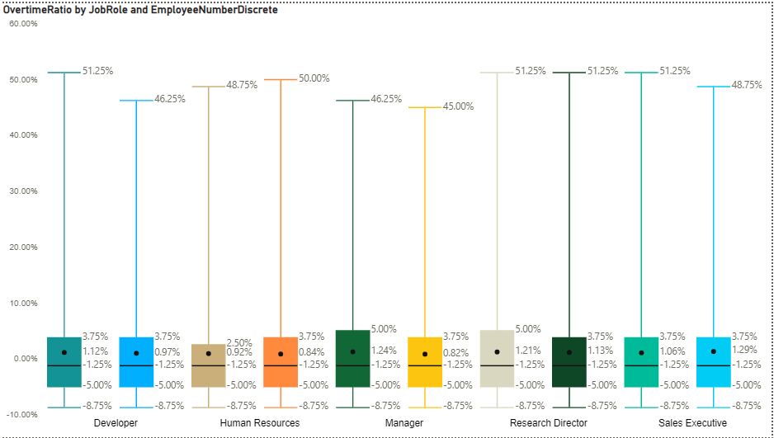
KPI 2 :Job Role / Overtime Ratio
Cards:
1) Overtime %
2) Overtime Hours
Considering Regular Hours to be 8
And Since we have calculated the
Hours worked for each employee,
Overtime Hours will be the Hours Worked – Regular Hours (only keeping the positive hours)
Now Overtime % = (Overtime Hours/Standard Hours)*100

Slide 7
KPI 2 :Job Role / Overtime Ratio
Explanation :
Its important to track the overtime % to identify where the problem is and take action to reduce overtime ratio.
It allows companies to evaluate the efficiency of their employee management process. (make decisions about employee policies, employee engagement, and employee retention).
A low overtime ratio can indicate a strong employee management process(Manufacturing Director)
In the graph As per Job role sales rep have the extreme Overtime % And Some actions need to be taken to reduce it to ensure better employee management.
Recommendations :
Company should invest in employee development and career opportunities.

Slide 8
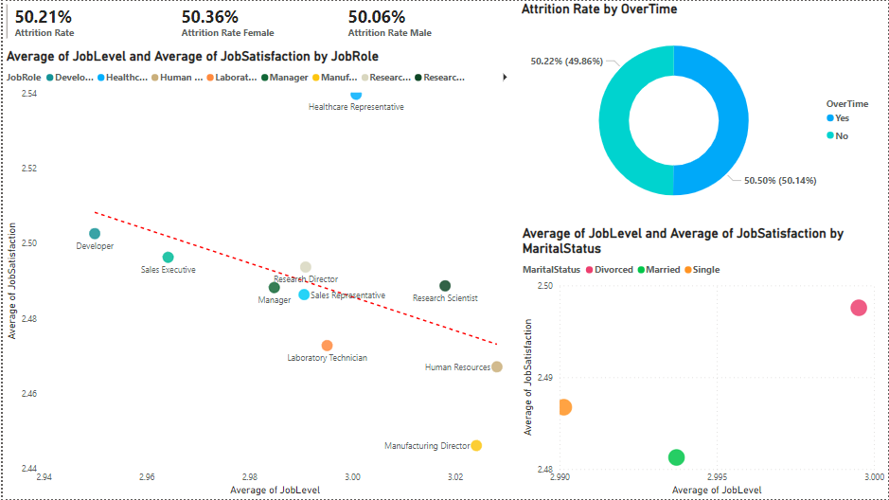
KPI 3 : Job Role/ Job Satisfaction for Female
Recommendations:
Promotions
Leadership Roles,
Mentorship Programs,
Networking and Collaboration.
Recreational Area.
Meditating and Wellness Sessions for peace of mind.

Slide 9
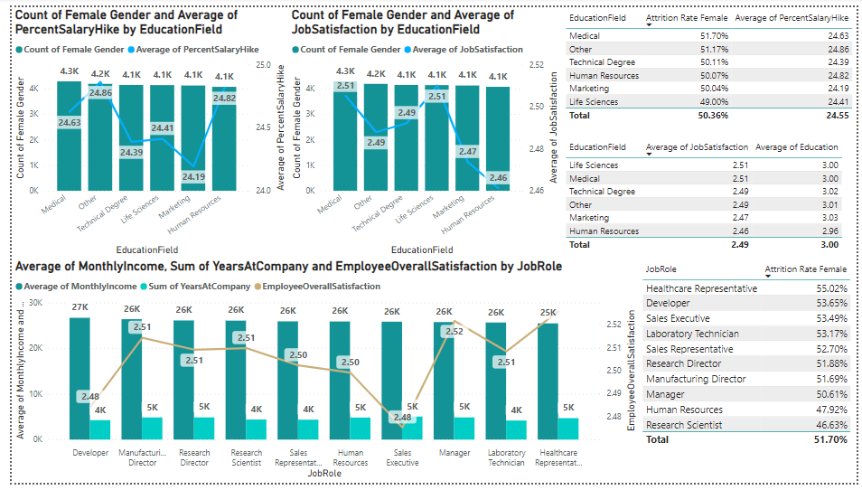
KPI 4 :Percent Salary Hike Education Field :
Explanation :
Employee Overall Satisfaction is, Highest And Monthly Pay is lowest also the Sum of years at the Company is Good
Recommendations :
Increasing the Percent Salary Hike for the Females coming from the Marketing Education Field.
Increasing the pay for the Health care Representatives

Slide 10
Thank you !

